Slide 1






Lecture 8:
JS Execution Concepts
Course - Web Development - II
-By
Instructor Name
welcome@krmangalam.edu.in
Sohna Road,Gurugram,Haryana 122103

Slide 2

| Table of Contents
Execution Context
Call Stack
Temporal Dead Zone (TDZ)
References.
The End.

Slide 3

|
When you open a website and click a button, how does the browser remember which line of JavaScript code to execute next, and why does it sometimes throw an error even before running the full script?

Slide 4
|
When you open a website and click a button, how does the browser remember which line of JavaScript code to execute next, and why does it sometimes throw an error even before running the full script?
To answer this, we need to understand:
Execution Context – where code runs
Call Stack – how code execution is managed
Temporal Dead Zone (TDZ) – why let and const behave strictly

Slide 5
| Execution Context
An Execution Context is a container or environment created by the JavaScript engine to run JavaScript code.
Every time JavaScript runs:
It creates an execution context
Stores variables, functions, and scope information
Executes code line by line
JavaScript cannot execute code without an execution context.

Slide 6
| Why Execution Context Is Important
Execution context helps JavaScript:
Know which variables belong where
Decide scope access
Assign the value of this
Execute code in the correct order

Slide 7
| Types of Execution Context
1. Global Execution Context (GEC)
Created when the page loads
Only one global context per page
In browsers:
  this refers to the window object
  Global var variables become part of window
2. Function Execution Context (FEC)
Created when a function is called
Each function call creates a new context
Has its own local memory and scope
Destroyed after function execution

Slide 8
| Execution Context Creation Phases
Phase 1: Memory Creation Phase (Hoisting)
During this phase:
Memory is allocated for variables
Function declarations are stored completely
var → initialized as undefined
let and const → hoisted but not initialized
No code is executed in this phase.

Slide 9
| Execution Context Creation Phases
Phase 2: Code Execution Phase
During this phase:
Code executes line by line
Values are assigned to variables
Functions are invoked

Slide 10
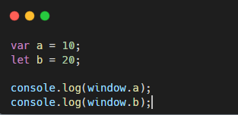
| Execution Context
Output
10
undefined
Explanation
a is part of global execution context and attached to window
b exists in script scope, not global object

Slide 11
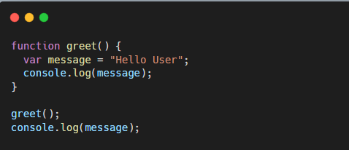
| Function Execution Context – Example
Explanation
message exists only inside function execution context
Browser removes it after function execution

Slide 12
| Call Stack
The Call Stack is a stack-based data structure used by the JavaScript engine to:
Track function calls
Maintain execution order
Know where to return after execution
JavaScript uses a single call stack, meaning it can execute only one task at a time.
How Call Stack Works
Global execution context is pushed first
Function calls push new execution contexts
Completed functions are popped out
Global Context
→ first()
→ second()
→ third()
← third() ends
← second() ends
← first() ends

Slide 13
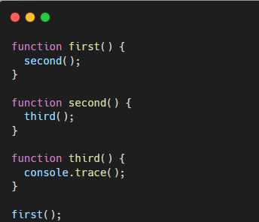
| Call Stack Trace
Browser prints the actual call stack

Slide 14
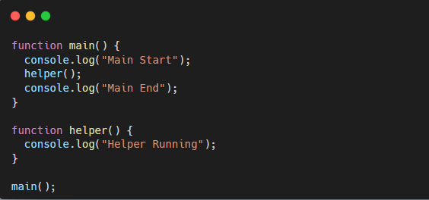
| Call Stack Execution Order Example
Main Start
Helper Running
Main End
Execution follows strict LIFO order

Slide 15
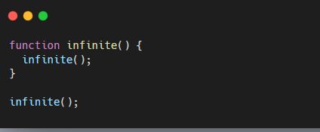
| Call Stack Overflow (Important Concept)
Browser Error
Uncaught RangeError: Maximum call stack size exceeded
Why This Happens
Call stack has limited memory
Infinite calls fill the stack
Browser stops execution to prevent crash

Slide 16
| Temporal Dead Zone (TDZ)
The Temporal Dead Zone (TDZ) is the time period between variable hoisting and initialization for let and const.
During TDZ:
Variable exists in memory
Accessing it causes a ReferenceError
Purpose of TDZ
Prevents bugs caused by accidental variable access
Forces developers to declare variables before use
Encourages predictable code behavior

Slide 17
| TDZ vs var
Feature | var | let | const
Hoisted | Yes | Yes | Yes
Initialized | undefined | ❌ | ❌
TDZ | ❌ | ✅ | ✅
Block scope | ❌ | ✅ | ✅

Slide 18

| TDZ vs var
Feature | var | let | const
Hoisted | Yes | Yes | Yes
Initialized | undefined | ❌ | ❌
TDZ | ❌ | ✅ | ✅
Block scope | ❌ | ✅ | ✅
Uncaught ReferenceError: Cannot access 'score' before initialization

Slide 19
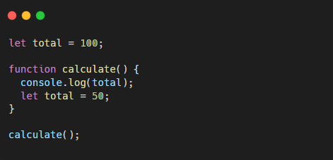
| Function-Level TDZ
Explanation
Local total shadows global
Local variable is in TDZ
Access causes error

Slide 20

| Check Your Understanding
Question : What is an Execution Context in JavaScript?
Options : a) A file where JavaScript code is stored
b) An environment where JavaScript code is executed
c) A browser tab
d) A JavaScript library
Answer : b) An environment where JavaScript code is executed
Explanation:
Execution context provides the environment needed to run JavaScript code.

Slide 21
| Check Your Understanding
Question : In a browser, what does this refer to in the global execution context?
Options : a) document
b) window
c) global
d) undefined
Answer : b) window
Explanation:
In browsers, the global execution context binds this to the window object.

Slide 22
| Check Your Understanding
Question : What data structure does JavaScript use to manage execution contexts?
Options : a) Queue
b) Tree
c) Heap
d) Stack
Answer : d) Stack
Explanation:
JavaScript uses a call stack to manage execution contexts.

Slide 23
| Check Your Understanding
Question : Accessing a variable in TDZ results in:
Options : a) undefined
b) null
c) SyntaxError
d) ReferenceError
Answer : d) ReferenceError
Explanation:
Accessing TDZ variables throws ReferenceError.

Slide 24
| References
MDN Web Docs : Comprehensive and official documentation for JS.
🔗https://developer.mozilla.org/en-US/docs/Web/JavaScript
W3Schools – JS Tutorial : Beginner-friendly JS tutorials with examples and interactive editors.
🔗 https://www.w3schools.com/js/
JavaScript.info - A comprehensive tutorial-style website that covers core JavaScript concepts in depth.
🔗https://javascript.info/

Slide 25
Thanks
For
Watching
Course - Web Development - II
welcome@krmangalam.edu.in
Sohna Road,Gurugram,Haryana 122103

